Slide 1
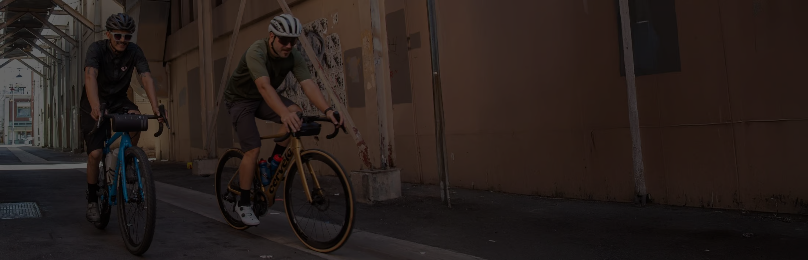

Jenson USA
SQL ANALYSIS
America's Bike & Adventure Shop

Slide 2
ABOUT COMPANY
Jenson USA is a leading American cycling retailer founded in 1994 and headquartered in Riverside, California. With over 30,000 products available online and at retail locations in Corona and Riverside, the company caters to enthusiasts of road, mountain, BMX, gravel, and commuter bikes. Jenson USA emphasizes a customer-centric approach, encapsulated in its core value: "Customers Are Everything.

Slide 3
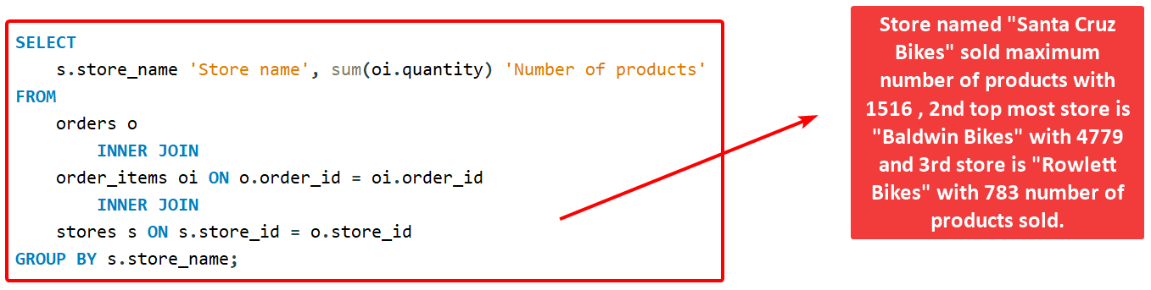
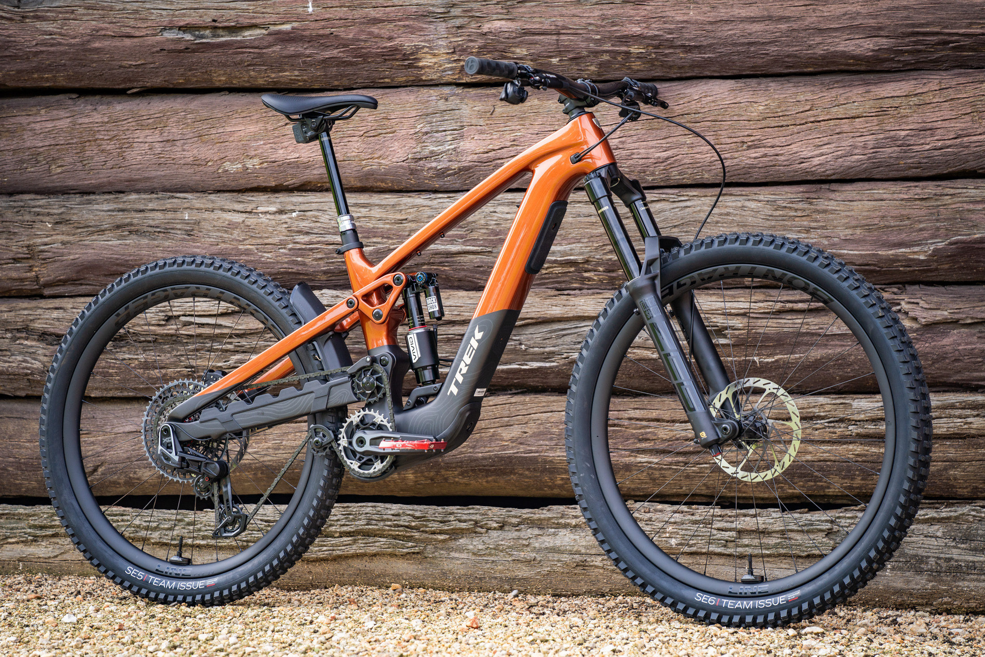
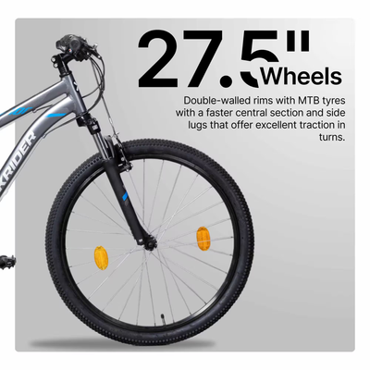
1.Find the total number of products sold by each store along with the store name.
QUERY

Slide 4
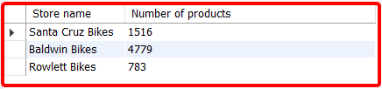
OUTPUT

Slide 5
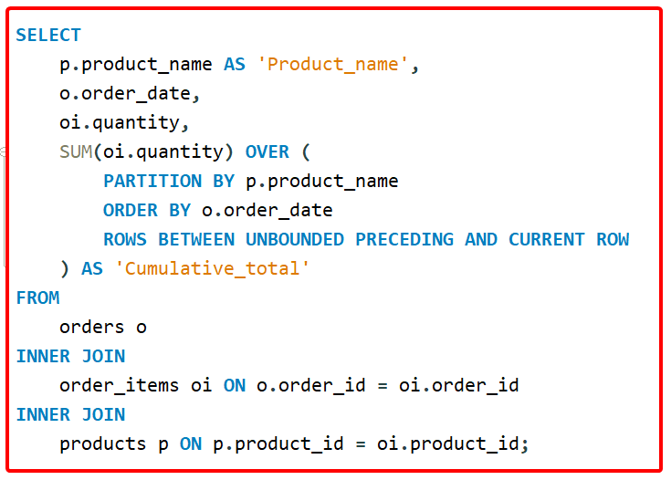
2.Calculate the cumulative sum of quantities sold for each product over time.
QUERY

Slide 6
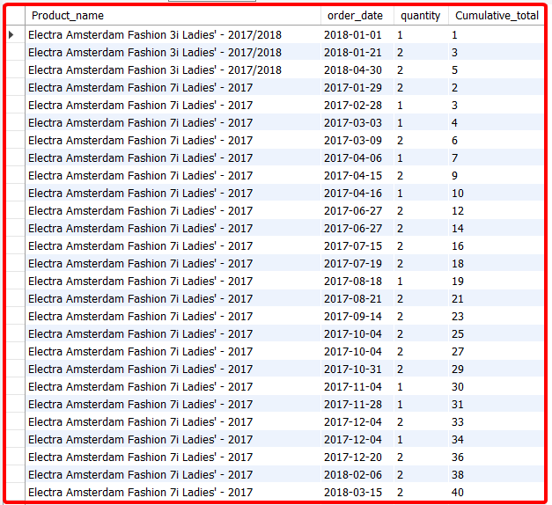
OUTPUT

Slide 7
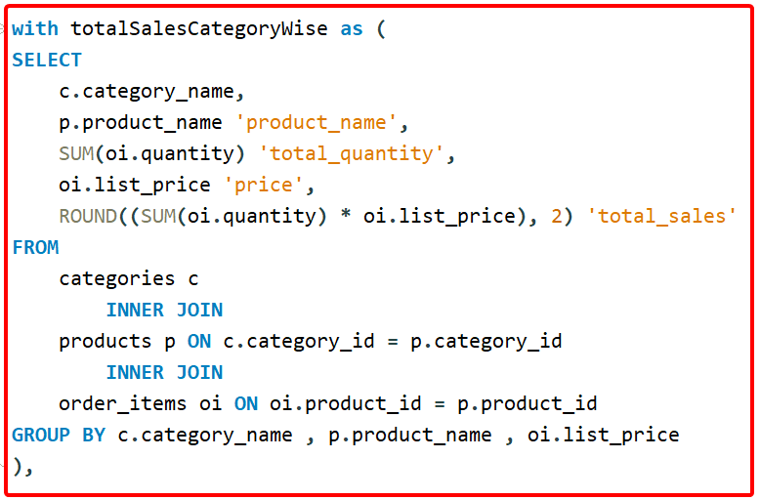
3.Find the product with the highest total sales (quantity * price) for each category.
QUERY

Slide 8
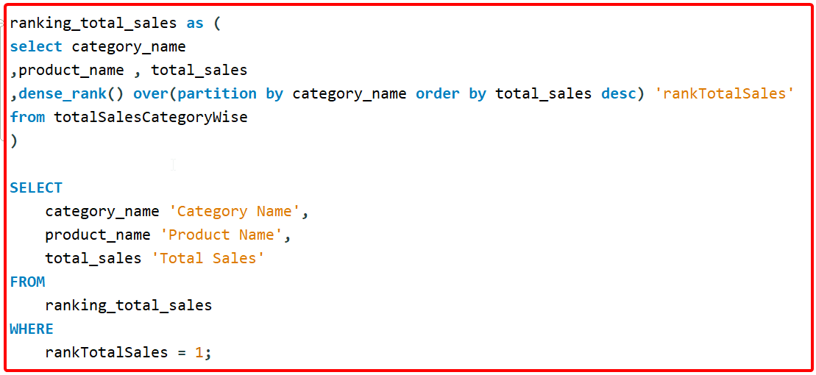
QUERY

Slide 9
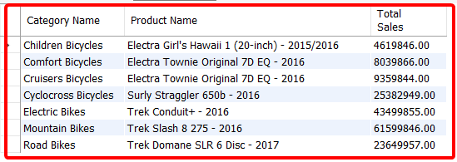
OUTPUT

Slide 10
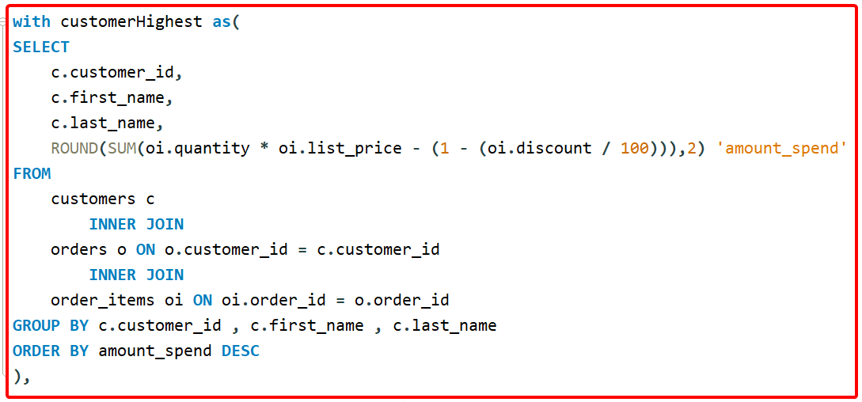
4.Find the customer who spent the most money on orders.
QUERY

Slide 11
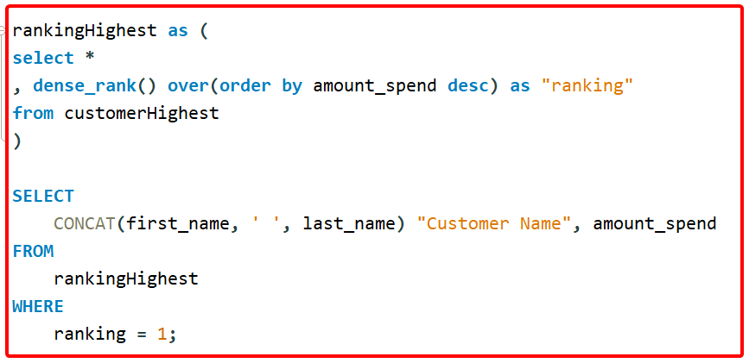
QUERY

Slide 12
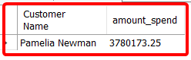
OUTPUT

Slide 13
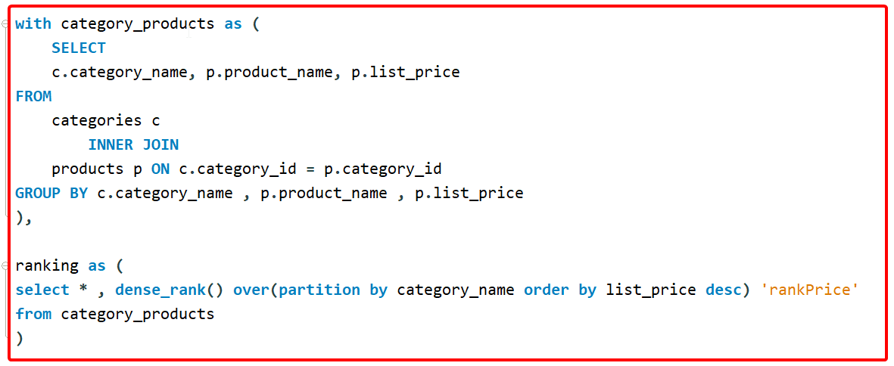
5.Find the highest-priced product for each category name.
QUERY

Slide 14
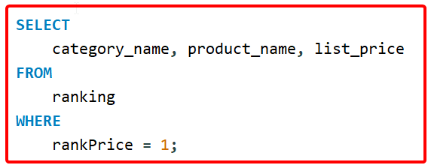
QUERY

Slide 15
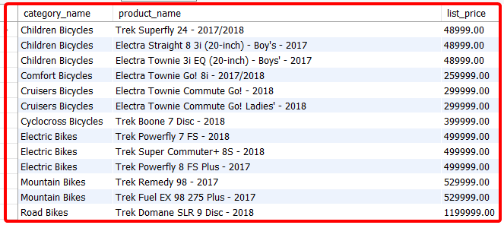
OUTPUT

Slide 16
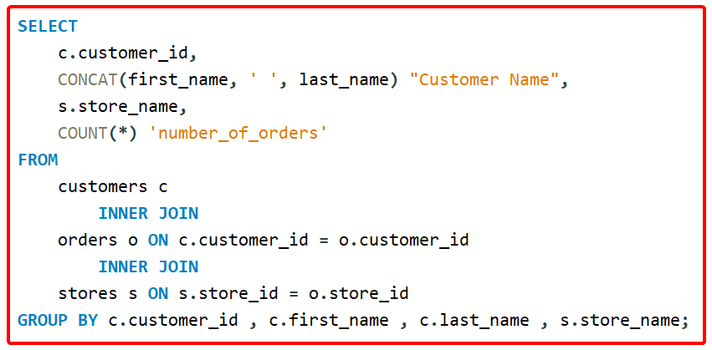
6.Find the total number of orders placed by each customer per store.
QUERY

Slide 17
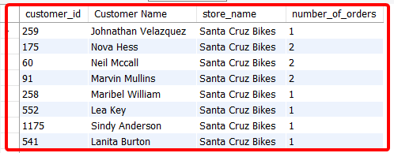
OUTPUT

Slide 18
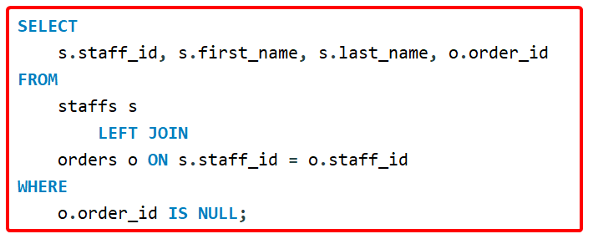
7.Find the names of staff members who have not made any sales.
QUERY

Slide 19
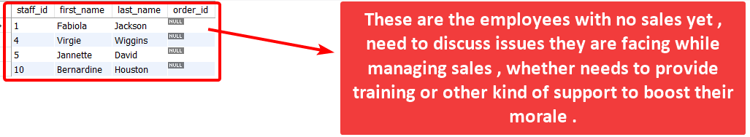
OUTPUT

Slide 20
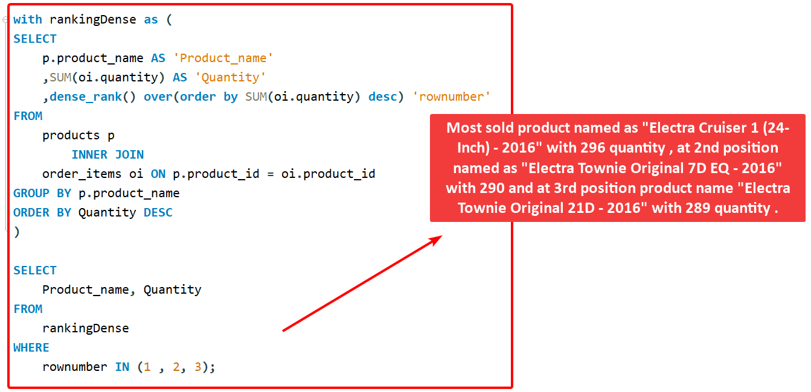
8.Find the top 3 most sold products in terms of quantity.
QUERY

Slide 21
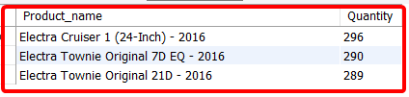
OUTPUT

Slide 22
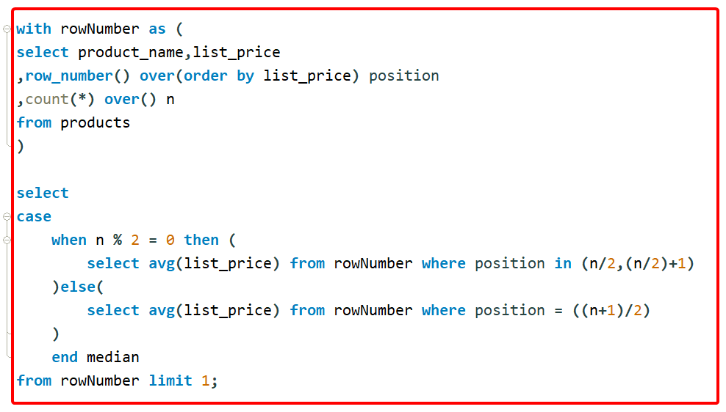
9.Find the median value of the price list.
QUERY

Slide 23
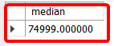
OUTPUT

Slide 24
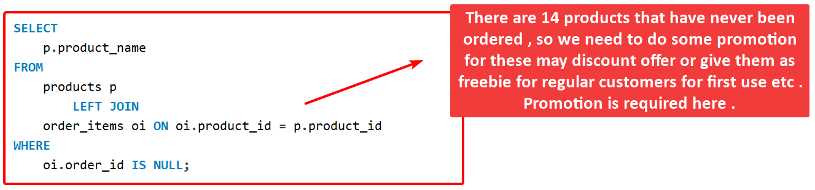
10.List all products that have never been ordered.
QUERY

Slide 25
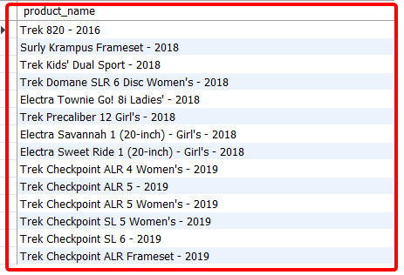
OUTPUT

Slide 26
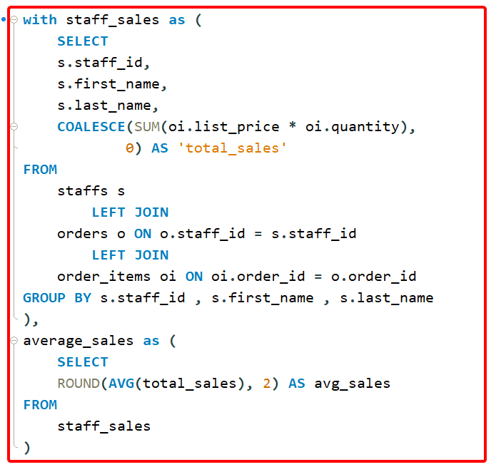
11.List the names of staff members who have made more sales than the average number of sales by all staff members.
QUERY

Slide 27
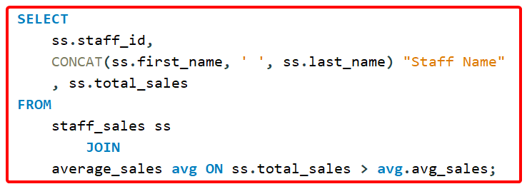
QUERY

Slide 28
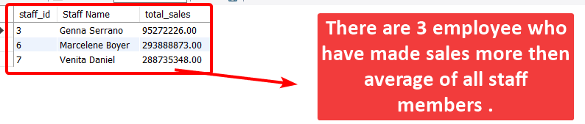
OUTPUT

Slide 29
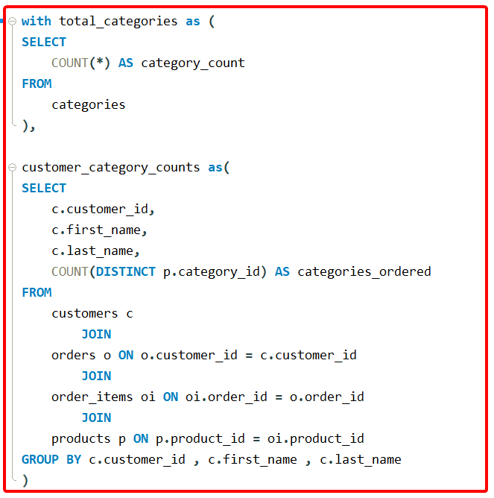
12.Identify the customers who have ordered all types of products (i.e., from every category).
QUERY

Slide 30
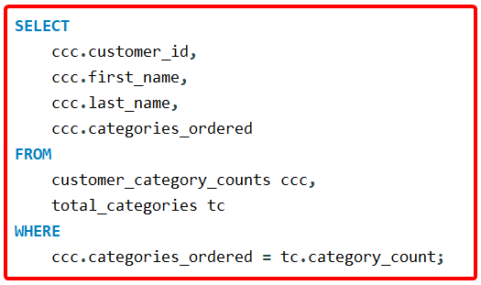
QUERY

Slide 31
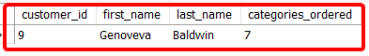
OUTPUT

Slide 32
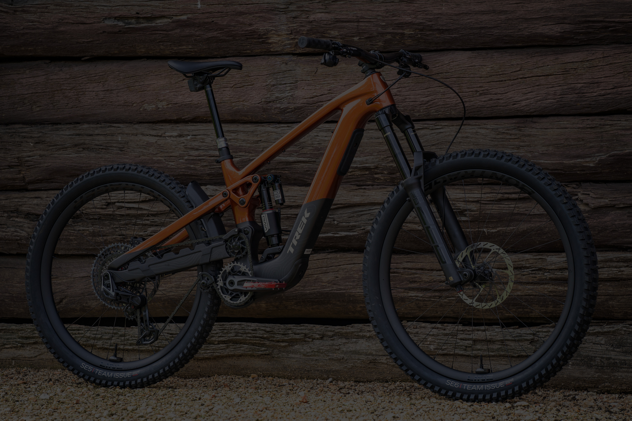
THANK YOU
2025 Jenson USA Presentation
BY FAROOK MOHAMMAD

